Slide 1

Super Cool Workspace
by So Called Engineers

Slide 2




SUPER COOL WORKSPACE
K MUGUNTHAN
AAROON D SANJU
A A GOWTHAM
E DINESH KUMAR
TEAM MEMBERS

Slide 3






INTRODUCTION
What does Emotion Recognition mean?
Emotion recognition is a technique used in software that allows a program to "read" the emotions on a human face using advanced image processing.
Companies have been experimenting with combining sophisticated algorithms with image processing techniques that have emerged in the past ten years to understand more about what an image or a video of a person's face tells us about how he/she is feeling and not just that but also showing the probabilities of mixed emotions a face could has.

Slide 4
AIM
Super Cool Workspace
A place where everyone is happy and satisfied.
To capture the emotions of employees during various times automatically without having to manually key in the ratings.
To analyze the movements of happiness index with various factors.
To map the captured emotions into a graph or chart during the real time.

Slide 5
Capturing Emotions of Employee
CNN MODEL
CV2
In deep learning, a convolutional neural network is a class of deep neural networks, most commonly applied to analyzing visual imagery.
01
04
OpenCV is a cross-platform library using which we can develop real-time computer vision applications. It mainly focuses on image processing, video capture and analysis including features like face detection and object detection.
KERAS
NUMPY
Keras is an open-source neural-network library written in Python.Designed to enable fast experimentation with deep neural networks, it focuses on being user-friendly, modular, and extensible.
02
05
NumPy is a library for the Python programming language, adding support for large, multi-dimensional arrays and matrices, along with a large collection of high-level mathematical functions to operate on these arrays.
IMUTILS
TENSOR FLOW
03
06
A series of convenience functions to make basic image processing functions such as translation, rotation, resizing, skeletonization, displaying Matplotlib images.
TensorFlow is a free and open-source software library for dataflow and differentiable programming across a range of tasks. It is a symbolic math library, and is also used for machine learning

Slide 6
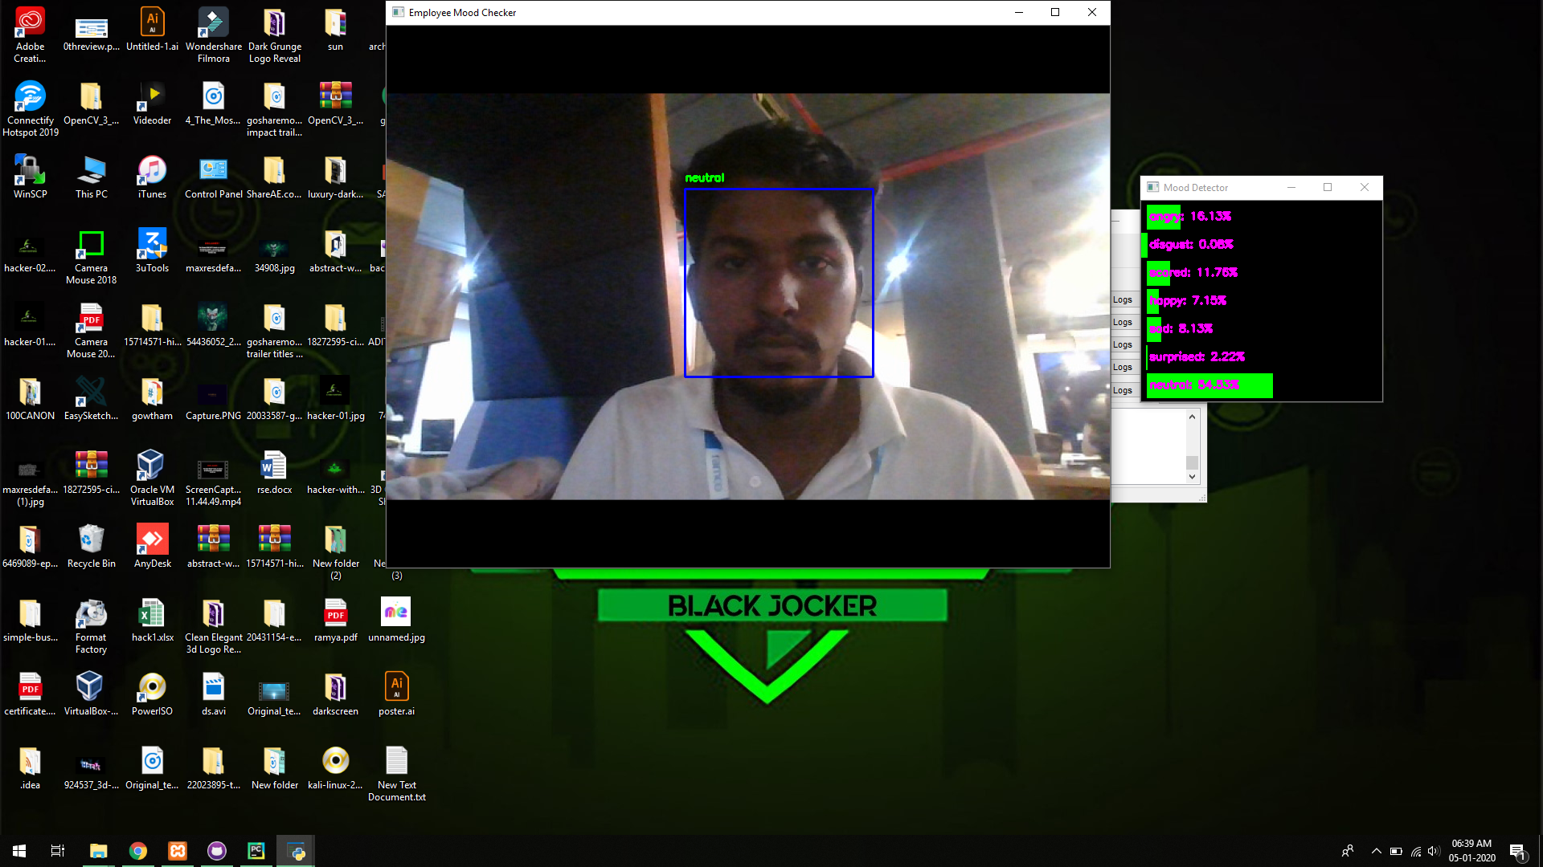
NEUTRAL FACE IDENTIFIED

Slide 7
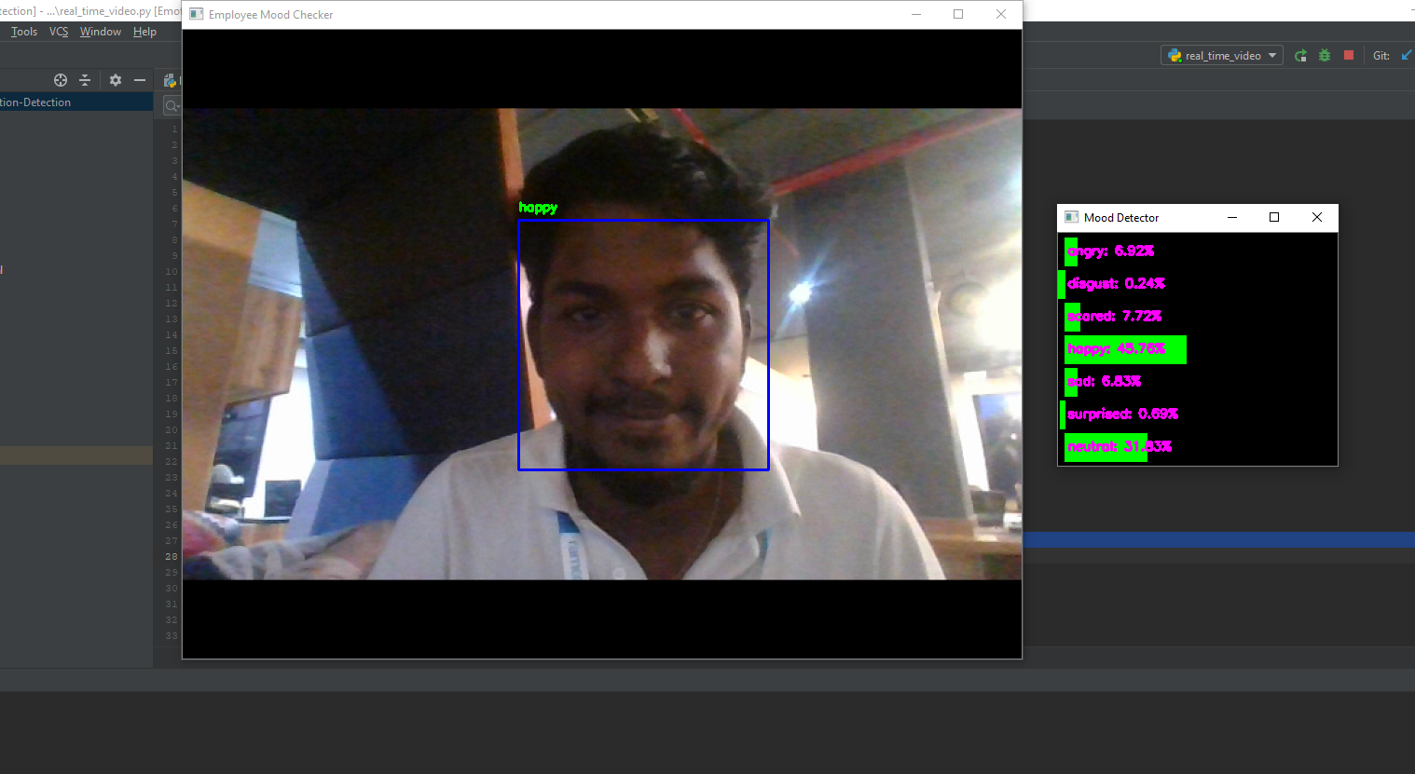
HAPPY FACE IDENTIFIED

Slide 8
WORKING PROCESS
Super Cool Workspace
A place where everyone is happy and satisfied.
Floating data of the identified image in which can be stored in the sql by using MYSQL.CONNECT .
The data stored in Mysql has been manipulated using CHART MODELS in PHP.

Slide 9



E-Mail Trigger
All the analyzed data were converted into charts and were sent to HR of the company.
By using this , particular attitude or mindset of the employee can be monitored.
Data Mining
Orange tool
Soft BOT:
UI Path

Slide 10
CHART REPRESENTATION
BAR CHART
PIE CHART
DOUGHNUT CHART
VERTICAL CHART
HORIZONTAL CHART
RADAR CHART

Slide 11
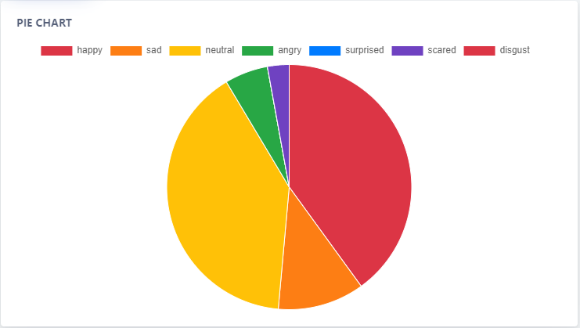
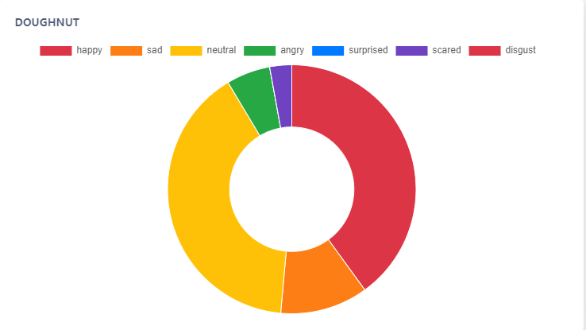

CHART REPRESENTATION
DOUGHNUT
PIE

Slide 12
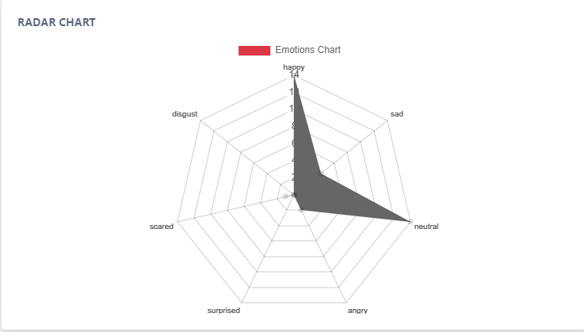
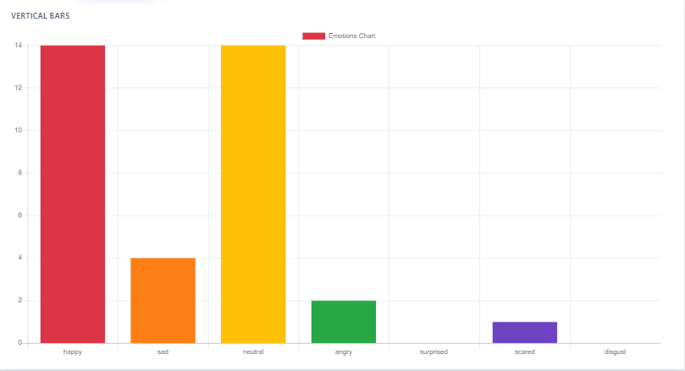
CHART REPRESENTATION
RADAR
VERTICAL BARS

Slide 13
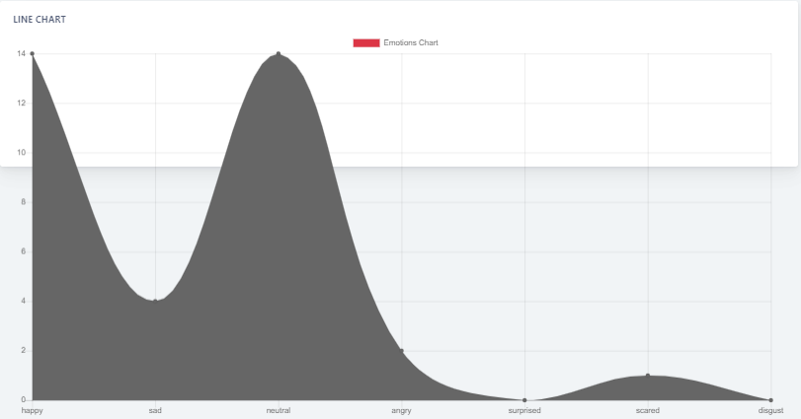
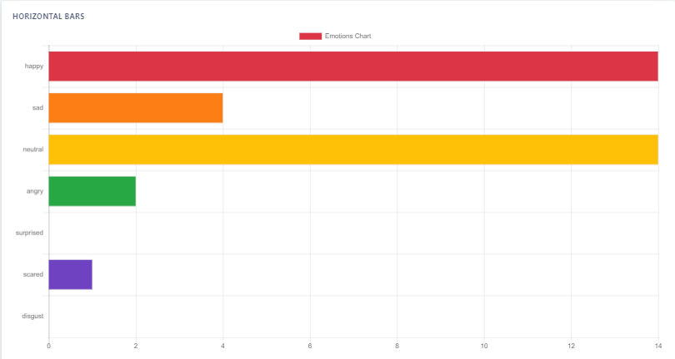
CHART REPRESENTATION
LINE
HORIZONTAL BARS

Slide 14
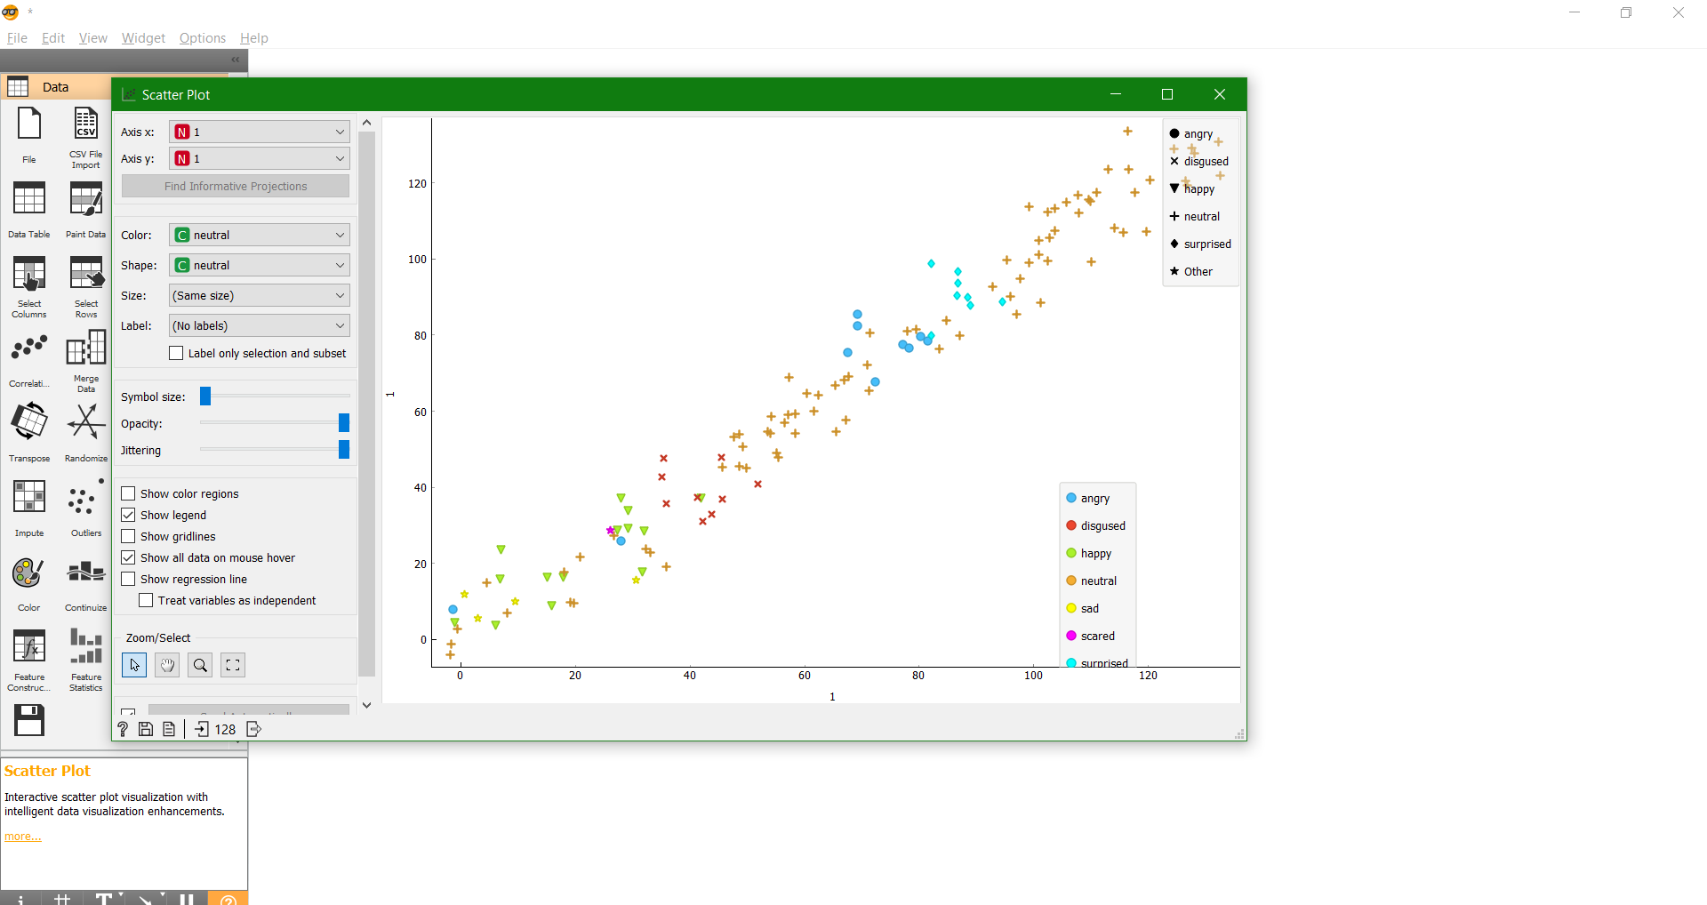
ORANGE TOOL DATA MINING

Slide 15
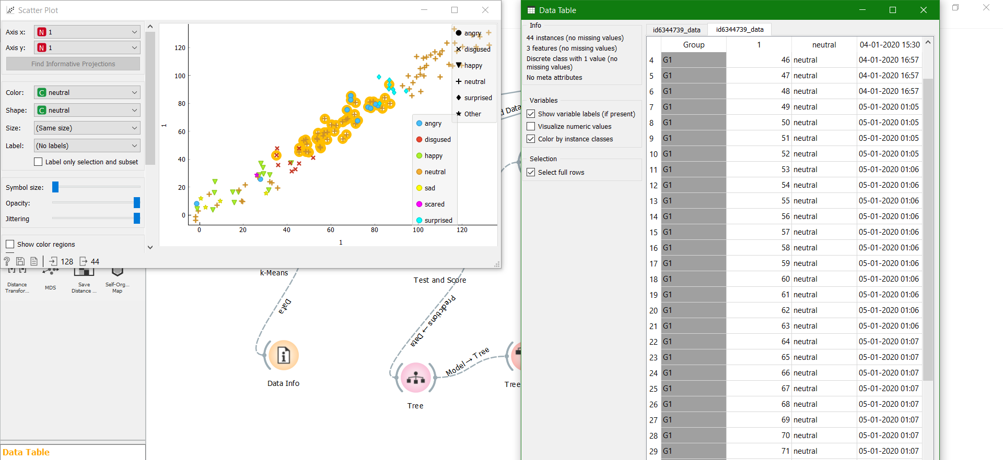
FILTERING DATA TABLE REPRESENTATION

Slide 16

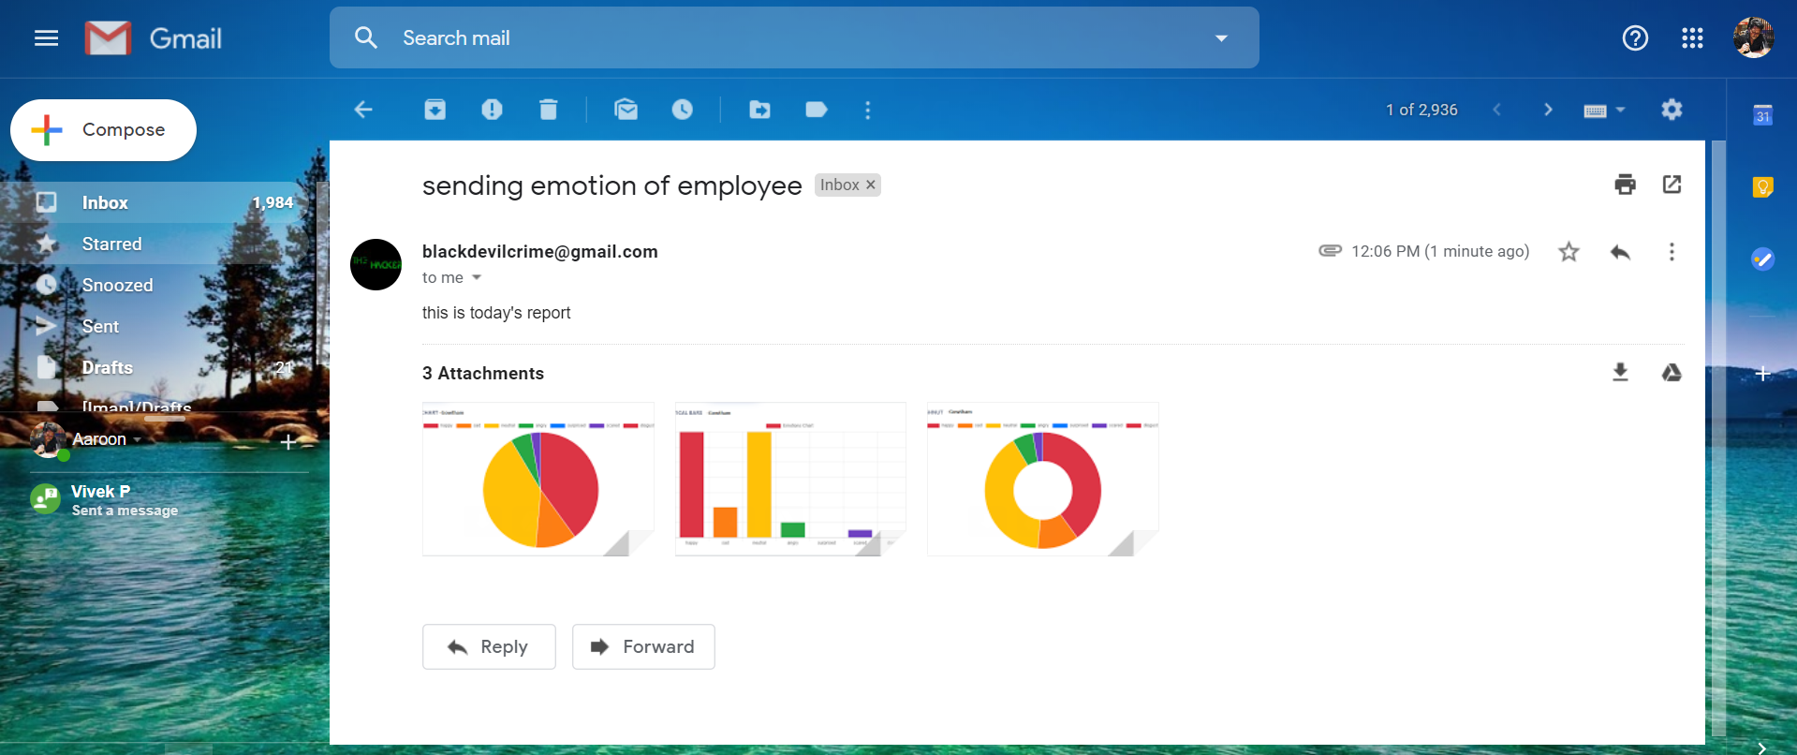
RECEIVING MAIL FROM SOFT BOT

Slide 17
Pros & Cons
Pros
Cons
Employee face expression is monitored at a regular interval of time.
Cost efficient.
Easy Implementation.
Greater Speed.
Privacy and Security.
A person who is monitored will feel discomfort under his working environment.

Slide 18
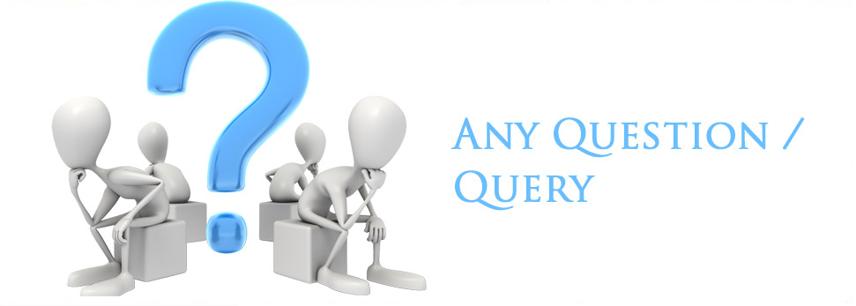

Slide 19

THANK
YOU

